Slide 1
22C:19 Discrete Structures Advanced Counting
Spring 2014
Sukumar Ghosh

Slide 2
Compound Interest
A person deposits $10,000 in a savings account that yields
10% interest annually. How much will be there in the account
After 30 years?
Let P_{n} = account balance after n years.
Then P_{n} = P_{n-1} + 0.10 P_{n-1} = 1.1P_{n-1}
Note that the definition is recursive.
What is the solution P_{n}?

Slide 3
Recurrence Relation
Recursively defined sequences are also known as recurrence relations. The actual sequence is a solution of the recurrence relations.
Consider the recurrence relation: a_{n+1} = 2a_{n} (n > 0) [Given a₁=1]
The solution is: 1, 2, 4, 8, 16 …., i.e. a_{n} = 2^{n-1}
So, a₃₀ = 2²⁹
Given any recurrence relation, can we “solve” it?

Slide 4
Example of Recurrence Relations
Fibonacci sequence: a_{n} = a_{n-1} + a_{n-2} (n>2) [Given a₁ = 1, a₂ = 1]
What is the formula for a_{n}?
2. Find the number of bit strings of length n that do not have two consecutive 0s.
For n=1, the strings are 0 and 1
For n=2, the strings are 01, 10, 11
For n=3, the strings are 011, 111, 101, 010, 110
Do you see a pattern here?

Slide 5
Example of Recurrence Relations
Let a_{n} be the number of bit strings of length n that do not have two consecutive 0’s.
a_{n} = a_{n-1} + a_{n-2} (why?)
[bit string of length (n-1) without a 00 anywhere] 1 (a_{n-1})
and [bit string of length (n-2) without a 00 anywhere] 1 0 (a_{n-2})
a_{n} = a_{n-1} + a_{n-2} is a recurrence relation. Given this, can you find a_{n}?

Slide 6
Tower of Hanoi
Transfer these disks from one peg to another. However, at no time, a disk
should be placed on another disk of smaller size. Start with 64 disks. When
you have finished transferring them one peg to another, the world will end.

Slide 7
Tower of Hanoi
Let, H_{n} = number of moves to transfer n disks. Then
H_{n} = 2H_{n-1} +1
Can you solve this and compute H₆₄? (H₁ = 1. why?)

Slide 8
Solving Linear Recurrence Relations
A linear recurrence relation is of the form
a_{n} = c₁.a_{n-1} + c₂. a^{n-2} + c₃. a^{n-3} + …+ c_{k}. a^{n-k}
(here c₁, c₂, …, c_{n} are constants)
Its solution is of the form a_{n} = r^{n} (where r is a constant) if and only if
r is a solution of
r^{n} = c₁.r^{n-1} + c₂. r^{n-2} + c₃. r^{n-3} + …+ c_{k}. r^{n-k}
This equation is known as the characteristic equation.

Slide 9
Example 1
Solve: a_{n} = a_{n-1} + 2 a_{n-2} (Given that a₀ = 2 and a₁ = 7)
Its solution is of the form a_{n} = r^{n}
The characteristic equation is: r² = r + 2, i.e. r² - r - 2 = 0. It has two roots r = 2, and r = -1
The sequence {a_{n}} is a solution to this recurrence relation iff
a_{n} = α₁ 2^{n} + α₂ (-1)^{n}
a₀ = 2 = α₁ + α₂
a₁ = 7 = α₁. 2 + α₂.(-1) This leads to α₁= 3 + α₂ = -1
So, the solution is a_{n} = 3. 2^{n} - (-1)^{n}

Slide 10
Example 2: Fibonacci sequence
Solve: f_{n} = f_{n-1} + f_{n-2} (Given that f₀ = 0 and f₁ = 1)
Its solution is of the form f_{n} = r^{n}
The characteristic equation is: r² - r - 1 = 0. It has two roots
r = ½(1 + √5) and ½(1 - √5)
The sequence {a_{n}} is a solution to this recurrence relation iff
f_{n} = α₁ (½(1 + √5))^{n} + α₂ (½(1 - √5))^{n}
(Now, compute α1 and α2 from the initial conditions): α1 = 1/√5 and α2 = -1/√5
The final solution is f_{n} = 1/√5. (½(1 + √5))^{n} - 1/√5.(½(1 - √5))^{n}
☹

Slide 11
22C:19 Discrete Math Relations
Fall 2011
Sukumar Ghosh

Slide 12
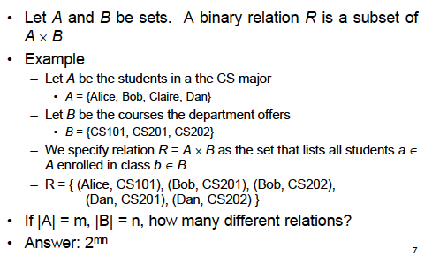
What is a relation?

Slide 13
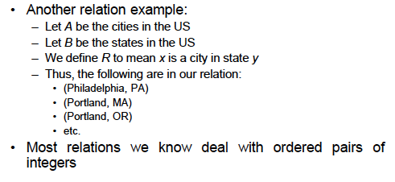
What is a relation?

Slide 14
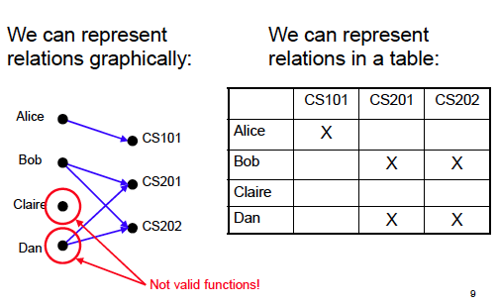
Representing Relations

Slide 15
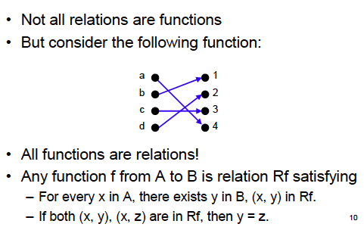
Relations vs. Functions

Slide 16
When to use which?
A function yields a single result for any element in its domain.
Example: age (of a person), square (of an integer) etc.
A relation allows multiple mappings between the domain
and the co-domain.
Example: students enrolled in multiple courses.

Slide 17
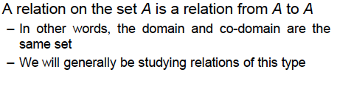
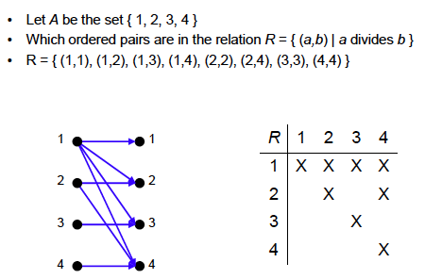
Relation within a set

Slide 18
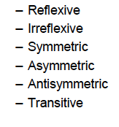
Properties of Relations
We study six properties of relations:
What are these?

Slide 19


Reflexivity
Example.
= is reflexive, since a = a
≤ is reflexive, since a ≤ a
< is not reflexive is a < a is false.

Slide 20
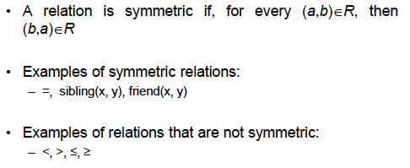
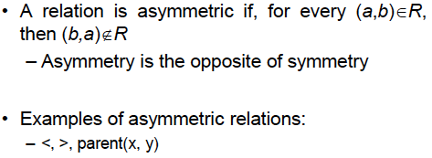
Symmetry

Slide 21
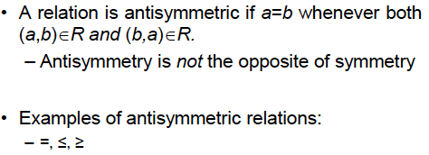

Anti-symmetry

Slide 22
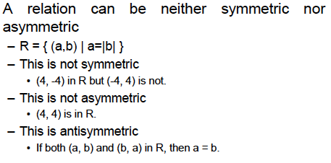
More on symmetric relations

Slide 23
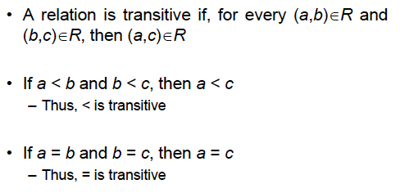
Transitivity

Slide 24
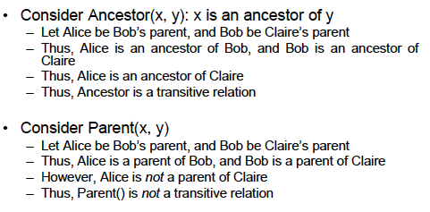
Examples of transitive relations

Slide 25
Summary of properties
 | = | < | > | ≤ | ≥
Reflexive | X |  |  | X | X
Irreflexive |  | X | X
Symmetric | X
Asymmetric |  | X | X | X | X
Antisymmetric | X |  |  | X | X
Transitive | X | X | X | X | X

Slide 26
Operations on relations
Let A = {1, 2, 3} and B = (1, 2, 3, 4}. Define two relations
R1 = {(1,1), (1,2), (1,3)}
R2 = {(1,1), (1,3), (1,4)}
Then,
R1 ⋃ R2 = {(1,1), (1,2), (1,3), (1,4)}
R1 ⋂ R2 = {(1,1), (1,3)}
R1 - R2 = {(1,2)}

Slide 27
More operations on relations: Composition
Let S be a relation from the set A to the set B, and R be
and R be a relation from the set B to the set C. Then, the
composition of S and R, denoted by S ◦ R is
{(a, c) | a ∈ A, b ∈ B, c ∈ C such that (a, b) ∈ S and (b, c) ∈ R}
EXAMPLE. Let A = {1, 2, 3}, B = { 1, 2, 3, 4}, C = {0, 1, 2}
S = {(1,1), (1,4), (2,3), (3, 1), (3, 4)}
R = {(1,0), (2,0), (3,1), (3, 2), (4,1)
Then S ◦ R = {(1,0), (1,1), (2,1), (2,2), (3,0), (3,1)

Slide 28
More operations on relations: Composition
R^{n} = R^{n-1} ◦ R = R ◦ R ◦ R ◦ R … (n times)
EXAMPLE. Let R = {(1,1), (2,1), (3,2), (4,3)},. Then
R² = R ◦ R = {(1,1), (2,1), (3, 1), (4,2)}
R³ = R² ◦ R = {(1,1), (2,1), (3, 1), (4,1)}
R⁴ = R³ ◦ R = {(1,1), (2,1), (3, 1), (4,1)}
Notice that in this case for all n > 3, R^{n} = R³

Slide 29
n-ary relations
Has important applications in computer databases.
DEFINITION. Let A₁, A₂, A₃, …, A_{n} be n sets. An n-ary relation
is a subset of A₁ x A₂ x A₃ x… x A_{n}
EXAMPLE. R is a relation on N x N x N consisting of triples
(a, b, c) where a < b < c. Thus (1, 2, 3) ∈ R but (3, 6, 2) ∉ R
b

Slide 30
Relational Data Model
Student Record
Name | ID | Major | GPA
Alice | 211 324 | Physics | 3.67
Bob | 123 456 | ECE | 3.67
Carol | 351 624 | ECE | 3.75
David | 000 888 | Computer Science | 3.25
The above table can be viewed as a 4-ary relation consisting of the 4-tuples
(Alice, 211324, Physics, 3.67)
(Bob, 123456, ECE, 3.67)
(Carol, 351624, ECE, 3.75)
(David, 000888, Computer Science, 3.25)

Slide 31
Relational Data Model
Name | ID | Major | GPA
Alice | 211 324 | Physics | 3.67
Bob | 123 456 | ECE | 3.67
Carol | 351 624 | ECE | 3.75
David | 000 888 | Computer Science | 3.25
A domain is called a primary key when no two n-tuples
in the relation have the same value from this domain.
(These are marked red).

Slide 32
Operations on n-ary relations
SELECTION
Let R be an n-ary relation, and C be a condition that the
elements in R must satisfy. Then the selection operator
S_{C} maps the n-ary relation R to the n-ary relations from R
that satisfy the condition C.
Essentially it helps filter out tuples that satisfy the desired
properties. For example, you may filter out the tuples for all
students in ECE, or all students whose GPA exceeds 3.5.

Slide 33
Operations on n-ary relations
PROJECTION
The projection P_{i,j,k,…,m} maps each n-tuple (a₁, a₂, a₃, …, a_{n})
to the tuple (a_{i}, a_{j}, a_{k}, …, a_{m}).
Essentially it helps you delete some of the components of each n-tuple.
Thus, in the table shown earlier, the projection P_{1,4} will retain only that
part of the table that contains the student names and their GPAs.

Slide 34
Use of the operations on n-ary relations
SQL queries
SQL queries carry out the operations described earlier:
SELECT GPA
FROM Student Records
WHERE Department = Computer Science

Slide 35
Representing Relations Using Matrices
A relation between finite sets can be represented using a 0-1 matrix.
Let A = {a₁, a₂, a₃} and B = {b₁, b₂, b₃}. A relation R from A to B can be
represented by a matrix M_{R}, where m_{ij} = 1 if (a_{i}, b_{j}) ∈ R, otherwise m_{ij} = 0
b1
b2
b3
a1
0
0
0
a2
1
0
0
a3
1
1
0
The above denotes a relation R from A = {1,2,3} to B = {1,2,4}, where for each element
(a, b) of R, a > b

Slide 36
Representing Relations Using Matrices
A reflexive relation on a given set A is recognized by a 1 along the diagonal
1
1
0
0
0
1
1
0
1
1
1
1
0
A reflexive relation
A symmetric relation

Slide 37
Representing Relations Using Digraph
A relation on a given set A can also be represented by a directed graph
1
2
3
2
1
1
0
0
1
1
2
1
0
1
3
3
1
1
A directed graph representation
of the relation shown on the left
Let A = {1, 2, 3}

Slide 38
Equivalence Relations
An equivalence relation on a set S is a relation that is
reflexive, symmetric and transitive.
Examples are:
Congruence relation R = {(a,b) | a = b (mod m)}
(2) R = {(a, b) | L(a) = L(b)} in a set of strings of
English characters}, L(a) denotes the length of English
character string “a”

Slide 39
Partial Orders
A relation R on a set S is a partial order if it is reflexive,
anti-symmetric and transitive. The set is called a partially
ordered set, or a poset.
Examples are
(1) the ≥ relation,
(2) “x divides y” on the set of positive integers
(3) The relation ⊆ on the power set of a set S

Slide 40
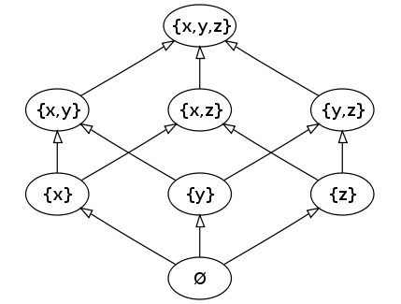
Partial Orders
The relation ⊆ on the power set of a set S forms a partially ordered set
Source: http://en.wikipedia.org/wiki/Partially_ordered_set

